Slide 1
Build and Deploy micro-service based app as Docker containers using Docker Compose
Docker compose file
worker:
build:
context: ./worker
networks:
- back-tier
redis:
image: redis:5.0-alpine3.10
ports:
- "6379:6379"
networks:
- back-tier
db:
image: postgres:9.4
environment:
POSTGRES_USER: "postgres"
POSTGRES_PASSWORD: "postgres"
volumes:
- "db-data:/var/lib/postgresql/data"
networks:
- back-tier
volumes:
db-data:
networks:
front-tier:
back-tier:
version: "3.7"
services:
vote:
build: ./vote
command: python app.py
volumes:
- ./vote:/app
ports:
- "5000:80"
networks:
- front-tier
- back-tier
result:
build: ./result
command: nodemon server.js
volumes:
- ./result:/app
ports:
- "5001:80"
networks:
- front-tier
- back-tier

Slide 2
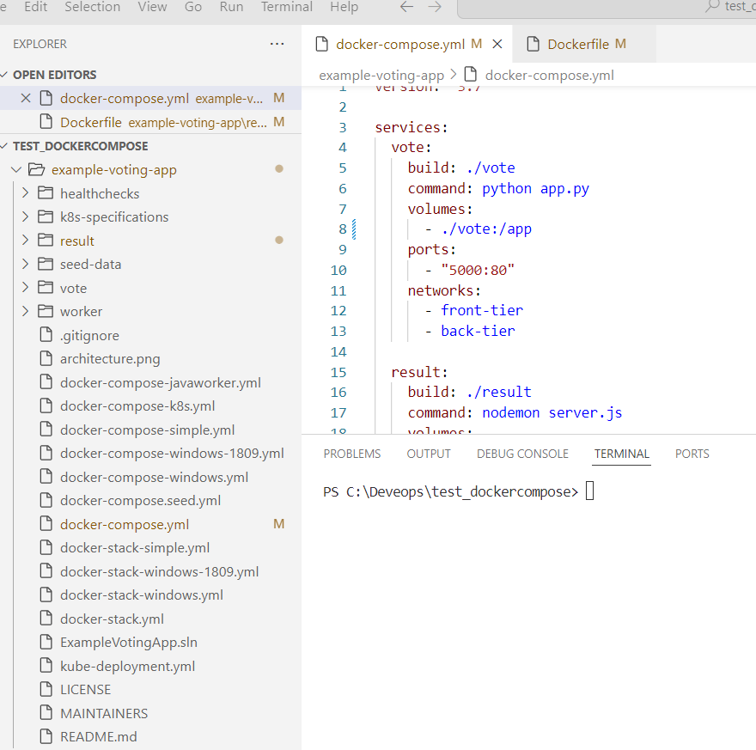
Git clone and pull all the files

Slide 3
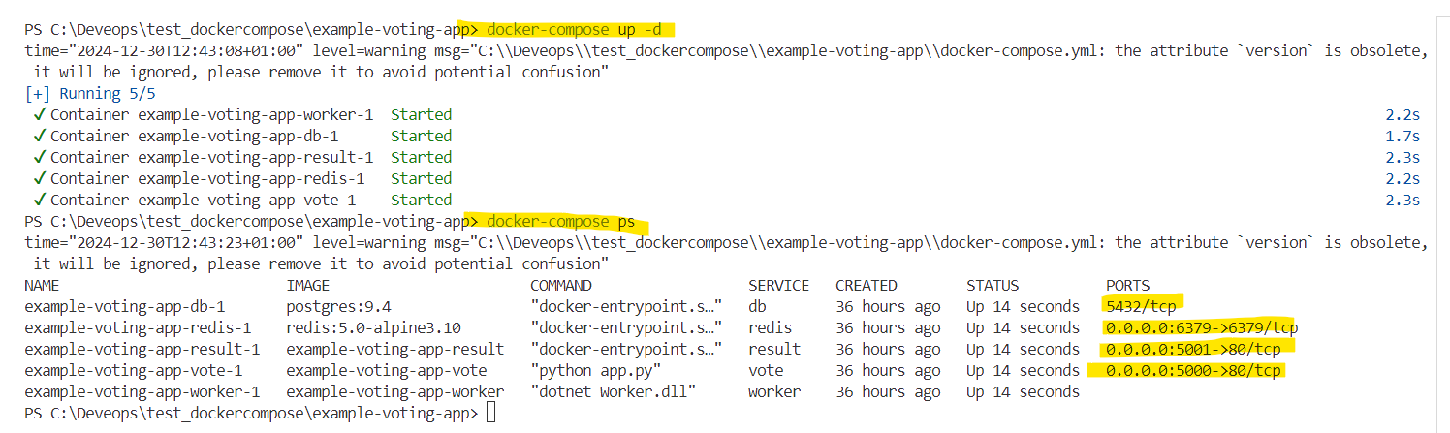
Run the containers
And list the containers

Slide 4
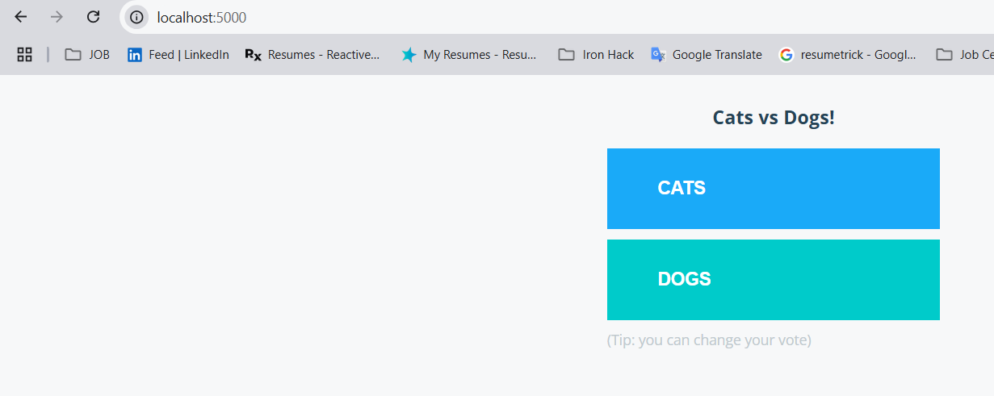
Check the vote app at port 5000

Slide 5
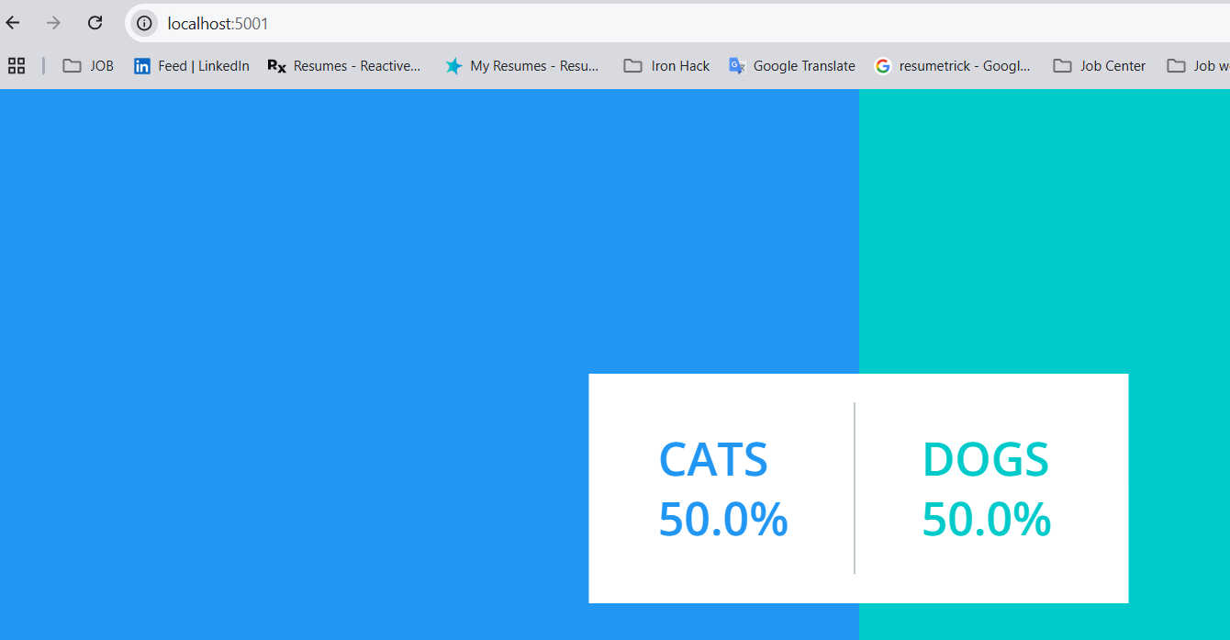
Check the vote app at port 5001

Slide 6
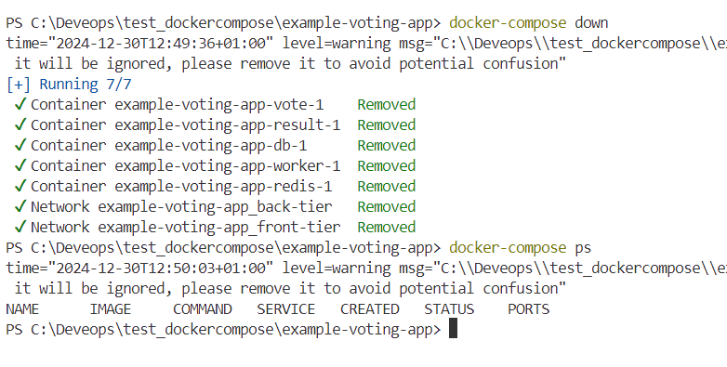
Stopping Containers

